Slide 1
Walk Wars
“Location-aware Application to Enable Improved Physical Fitness”
Sponsored by Dr. Michael Devetsikiotis
Group 7
Josh Crissman
John Manby
Michael Oglesby
Chun Sing Tsui

Slide 2
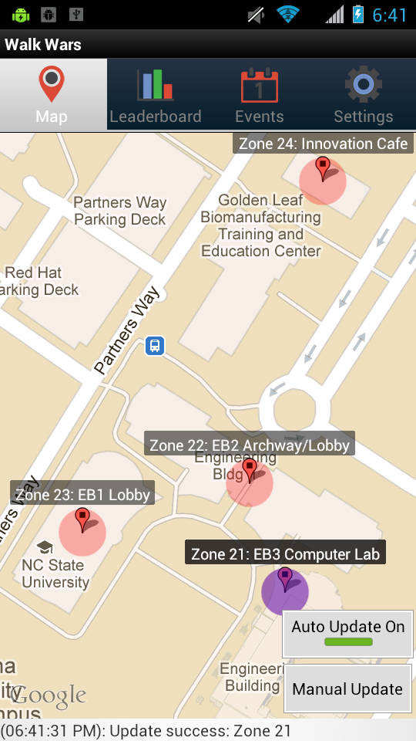

Overview
Android App
Powered by server backend
Points for visiting “zones”
Ability to form teams
Wi-Fi Localization
GPS not required

Slide 3
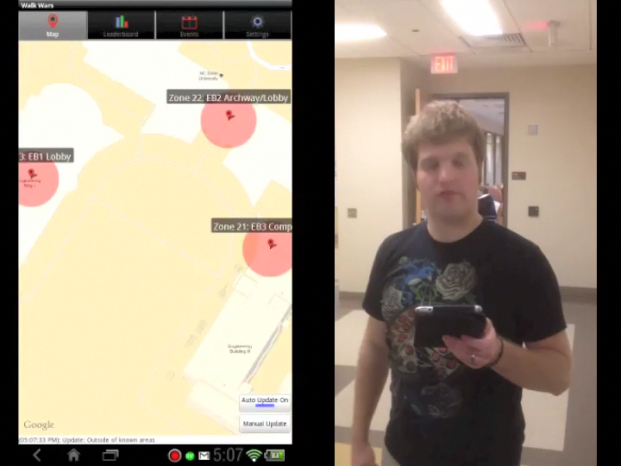
GAmeplay

Slide 4
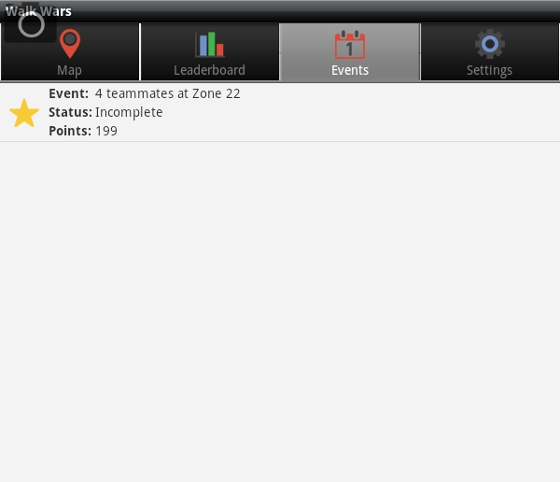
Events
Bonus Points
Random
Changes Daily

Slide 5
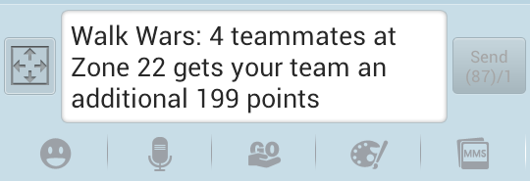
Social functionality
“Long press” on event
Opens messaging app
Presents user with pre-generated message

Slide 6
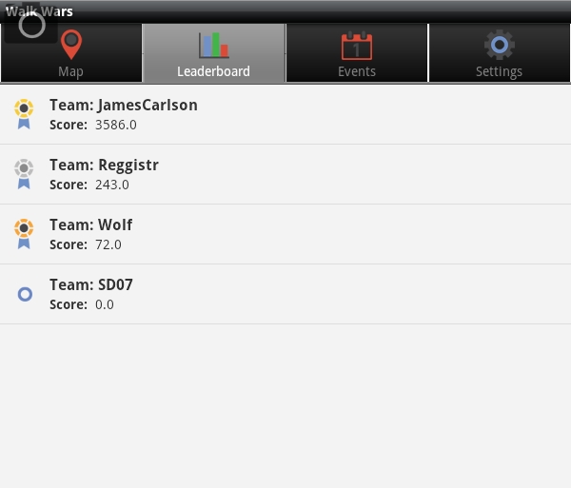
Leaderboard

Slide 7
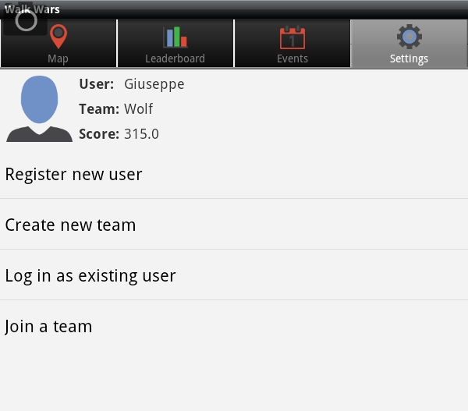
Settings

Slide 8
Expandability
4 zones as proof of concept
New zones could be added anywhere with Wi-Fi coverage
~7 minutes of Wi-Fi signal data collection required to add new zone

Slide 9
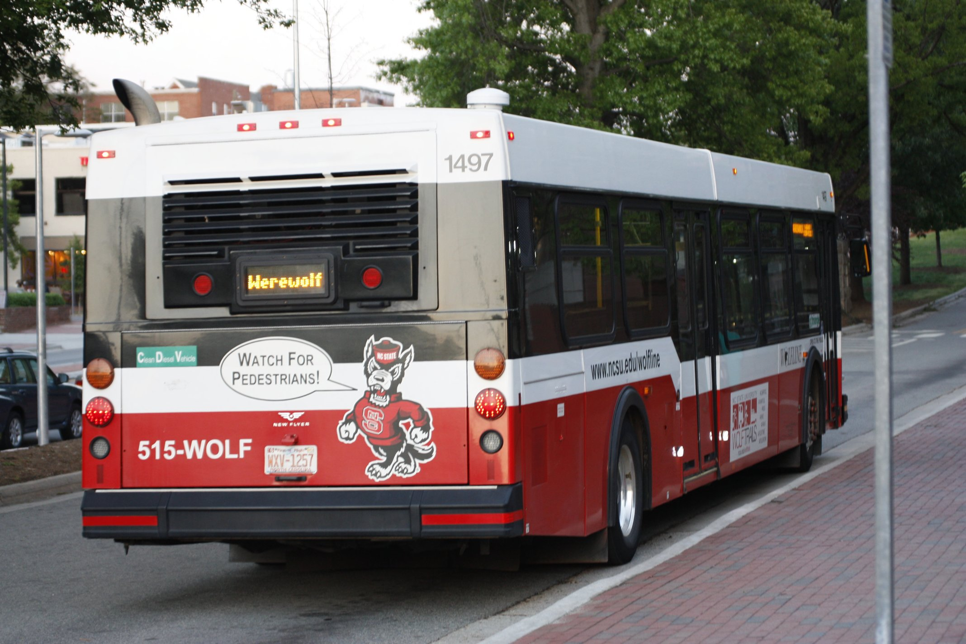
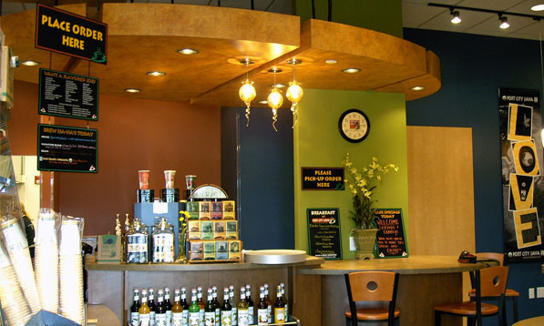
Possibilities
Social Functions
Alert: two friends are on the 3:30 Route 3 bus.
Alert: three friends are in a nearby zone, e.g. “Zone X – Port City Java”

Slide 10
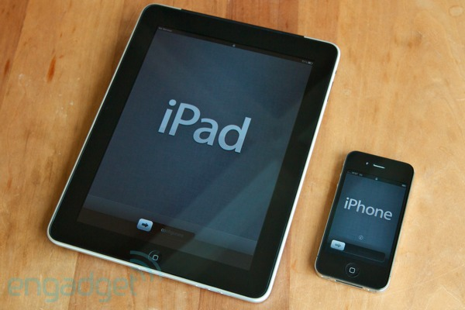
possibilities (Cont.)
iOS version
Would have to work around limitations
GPS functionality
Add zones in places with no Wi-Fi coverage

Slide 11
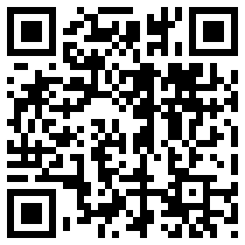
Try it now!

